Slide 1
KEYLOGGER
CAPSTONE PROJECT
Presented By:
YUVABHARATHI J - Jeppiaar Institute of Technology - B.E- CSE

Slide 2
OUTLINE
Problem Statement
Proposed System/Solution
System Development Approach
Algorithm & Deployment
Result
Conclusion
Future Scope
References

Slide 3
PROBLEM STATEMENT
In today's digital landscape, ensuring security measures to protect sensitive information is paramount. However, there exists a necessity to understand and mitigate potential threats, such as keylogging, which can compromise data integrity and confidentiality. Thus, it's imperative to explore keylogger implementation and associated security concerns.

Slide 4
PROPOSED SOLUTION
Our proposed system entails the development of a keylogger using Python's Tkinter library for the GUI, alongside the pynput library for capturing keyboard inputs. The keylogger records keystrokes and saves them in both text and JSON formats for comprehensive analysis.

Slide 5
SYSTEM APPROACH
Technology Used:
Python: For programming the keylogger functionality.
Tkinter: For building the graphical user interface (GUI).
pynput: For capturing keyboard inputs.
JSON: For storing keystroke data in a structured format.

Slide 6
ALGORITHM & DEPLOYMENT
Initialization: Initialize necessary variables and flags.
Event Handling:
  on_press(key): Records pressed and held keys.
  on_release(key): Records released keys and manages flag state.
Logging:
  generate_text_log(key): Saves keystrokes in a text file.
  generate_json_file(keys_used): Saves keystrokes in a JSON file.
Keylogger Control:
  start_keylogger(): Initiates keylogging process.
  stop_keylogger(): Stops keylogging.

Slide 7
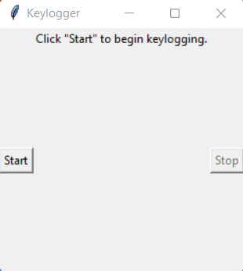
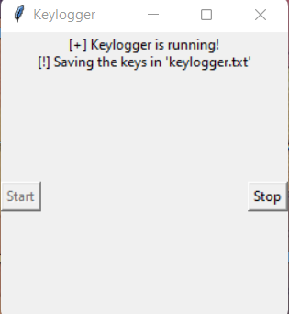
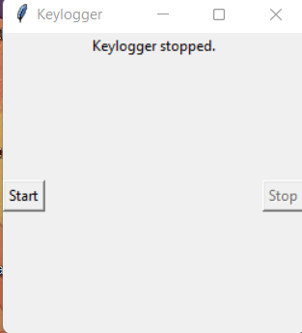
RESULT
The GUI presents "Start" and "Stop" buttons to control the keylogging process. Upon starting, the keylogger captures keystrokes and saves them in designated files. Stopping the keylogger halts the logging process.

Slide 8

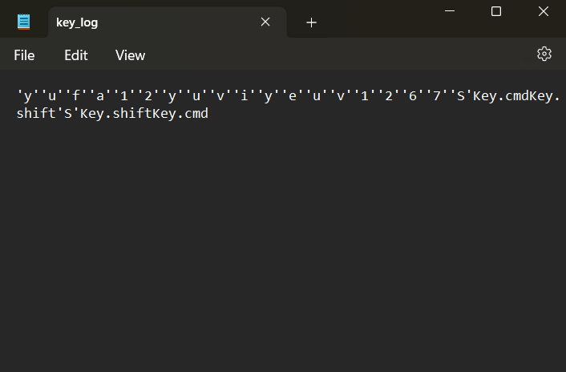
OUTPUT

Slide 9
CONCLUSION
Implementing a keylogger highlights the ease of capturing keyboard inputs and underscores the importance of robust security measures to prevent unauthorized access to sensitive information. Understanding keylogging techniques aids in fortifying systems against potential threats.

Slide 10
FUTURE SCOPE
Enhancing Security Measures: Implement encryption techniques to secure logged data.
User Authentication: Integrate user authentication mechanisms to prevent unauthorized access.
Advanced Logging: Implement advanced logging features, such as timestamping and window tracking.

Slide 11
REFERENCES
A Survey on Keylogger and its Detection Techniques by Vishal Bharti, Aditya Kumar Gupta, and Shailendra Mishra https://www.ijcaonline.org/archives/volume75/number5/12835-1514
Analysis of Keylogger Attacks and Countermeasures by Hongliang Liu, Ruiying Du, and Quansheng Zhuang https://www.semanticscholar.org/paper/Analysis-of-Keylogger-Attacks-and-Countermeasures-Liu-Du/54c7255bace229c82e4a5fd812ba8dd8829180c1
Detection of Keyloggers: A Review by Shukor Abd Razak, Ku Ruhana Ku-Mahamud, and Ramlan Mahmod https://www.researchgate.net/publication/220955239_Detection_of_Keyloggers_A_Review
A Comprehensive Study on Keylogger Attack and Defense by Shuo Chen, Rui Wang, XiaoFeng Wang, and Kehuan Zhang https://www.usenix.org/legacy/events/sec11/tech/full_papers/Chen.pdf

Slide 12
THANK YOU

